Slide 1
Authorisation
Prof. Odeo

Slide 2
Reminder:
Security Goals and Principles
  Goals:
  integrity - modification only by authorized parties
  confidentiality - access only by authorized parties
  non-repudiation - inability to disclaim authorship
  authenticity - verifiability of source
  availability - continuous access by authorized parties

Slide 3
Reminder:
Security goals and principles
Principles:
  least privilege - minimization of rights
  separation of duties (by task, by person)
  economy of mechanism - simplest means of enforcement
  acceptability – adoptable/usable by user community
  complete mediation - universal enforcement of control
  open design - secrecy of enforcement mechanisms is not important

Slide 4
Authorization
“… restrict the potential actions of users.
Aim is that the computing environment guarantee’s that only legitimate users can obtain access to computing facilities, and that only allowable and legitimate actions will be performed …”
Allowing 'legal', i.e. properly identified and authenticated people to only access those data and software files/databases to which they are allowed and authorized

Slide 5
Authorization
Authorization is the determination of whether a user has permission to access, read, modify, insert, or delete certain data, or to execute certain programs.
Access permissions are normally specified by a list of possibilities.
For example, UNIX allows the list { read, write, execute} as the list of possibilities for a user or group of users on a UNIX file.

Slide 6
Limitations of Authorisation
Authorization relies on Authentication
Effectiveness bounded by the system as a whole (e.g. buffer overflow)
Misbehavior of users, social component
Insider threat

Slide 7
Policies and Mechanisms
A security policy states what is, and is not allowed
  This defines “security” for the site/system/etc.
  Policy definition: Informal? Formal?
Mechanisms enforce policies
Composition of policies
  If policies conflict, discrepancies may create security vulnerabilities

Slide 8
Assumption and Trust
Policies and mechanisms have implicit assumptions
Assumptions regarding policies
  Unambiguously partition system states into “secure” and “nonsecure” states
  Correctly capture security requirements
Mechanisms
  Assumed to enforce policy: i.e. ensure that the system does not enter “nonsecure” state
  Support mechanisms work correctly

Slide 9
Components of Authorization
Authorization has three components:
  a set of objects we will designate as O,
  a set of subjects designed as S,
  a set of access permissions designated as A.
The authorization rule is a function f that takes the triple (s, o, a) where s ∈ S, o ∈ O, a ∈ A and maps then into a binary-value T, where T = {true, false} as
f : S×O×A → (True, False).
When the value of the function f is true, this
signals full authorization to the resource.

Slide 10
Authorisation Models
RBAC – Role Bases Access Control
        (Role based, Policy configured)
DAC – Discretionary Access Control
        (Identity based, Owner controlled)
MAC – Mandatory Access Control
        (Lattice based, Policy controlled)
ABAC - Attribute Based Access Control

Slide 11
Role Based Access Control (RBAC)
RBAC - is an approach to restricting system access to authorized users. It is a newer alternative approach to MAC and DAC.
Within an org’n, roles are created for various job functions.
The permissions to perform certain operations ('permissions') are assigned to specific roles.

Slide 12
Role Based Access Control
Members of staff (or other users) are assigned particular roles, and through those role assignments acquire the permissions to perform particular system functions.
Unlike context-based access control (CBAC), RBAC does not look at the message context (such as where the connection was started from).

Slide 13
RBAC Conventions
When defining an RBAC model, the following conventions are useful:
S = Subject - A person or automated agent
R = Role - Job function or title which defines
an authority level
P = Permissions - An approval of a mode of
access to a resource
SE = Session - A mapping involving S, R and/or
P
SA = Subject Assignment
PA = Permission Assignment

Slide 14
RBAC Conventions
RH = Partially ordered role Hierarchy. RH can also be written: ≥
A subject can have multiple roles.
A role can have multiple subjects.
A role can have many permissions.
A permission can be assigned to many roles.

Slide 15
RBAC Conventions
A constraint places a restrictive rule on the potential inheritance of permissions from opposing roles, thus it can be used to achieve appropriate separation of duties.
For example, the same person should not be allowed to both create a login account and to authorize the account creation.

Slide 16
RBAC Conventions
Thus, using set theory notation:
  and is a many to many permission to role assignment relation.
  and is a many to many subject to role assignment relation.
The notation: x ≥ y means that x inherits the permissions of y.

Slide 17
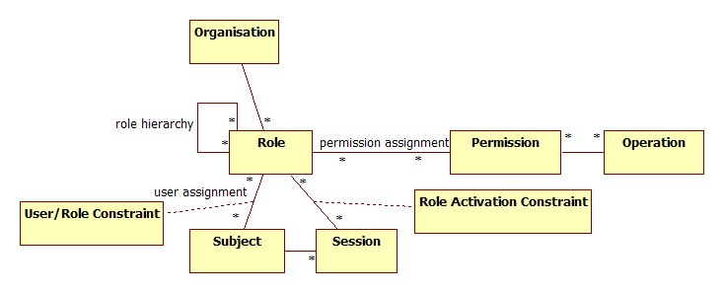
RBAC Conventions
A subject may have multiple simultaneous sessions with different permissions.

Slide 18
RBAC Implementation
Roles-users and roles-object access matrix
OBJECTS
 | R1 | R2 | … | Rn
V1 | X
V2 | X
V3 |  | X |  | X
V5 |  |  |  | X
…
Vm | X
 | R1 | R2 | R3 | F1 | F2 | P1 | P2 | D1 | D2
R1 | Control | Owner |  |  |  |  |  | seek | Owner
R2 |  |  |  |  |  |  |  | Owner
…
Rn |  |  | Control | Write | Stop

Slide 19
Discretionary Access Control
Discretionary access control (DAC) is a kind of access control defined by the Trusted Computer System Evaluation Criteria as "a means of restricting access to objects based on the identity of subjects and/or groups to which they belong.
The controls are discretionary in the sense that a subject with a certain access permission is capable of passing that permission (perhaps indirectly) on to any other subject (unless restrained by mandatory access control)".

Slide 20
Discretionary Access Control
Access decisions are typically based on the authorizations granted to a user based on the credentials he presented at the time of authentication (user name, password, hardware/software token, etc.).
The owner of information or any resource is able to change its permissions at his discretion (thus the name).
DAC has the drawback of the administrators not being able to centrally manage these permissions on files/information stored on the web server.

Slide 21
Characteristics of DAC
Data Owners can transfer ownership of information to other users
Data Owners can determine the type of access given to other users (read, write, copy, etc.)
Repetitive authorization failures to access the same resource or object generates an alarm and/or restricts the user's access

Slide 22
DAC Implementations
Draw illustrations:
Directory list
Access control list
Access control matrix

Slide 23
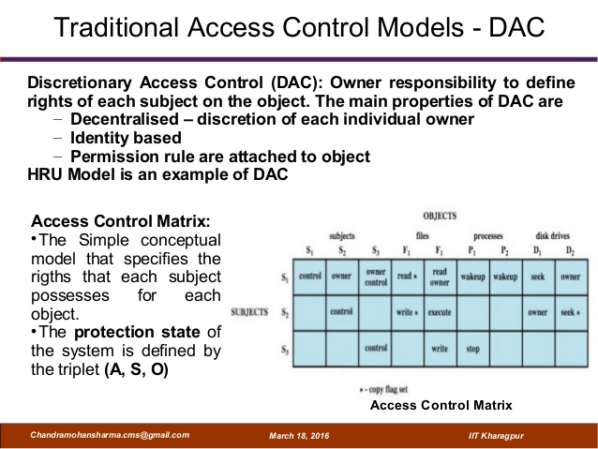


Slide 24
Mandatory Access Control
Mandatory access control (MAC) refers to a type of access control by which the operating system constrains the ability of a subject or initiator to access or generally perform some sort of operation on an object or target.
In practice, a subject is usually a process or thread; objects are constructs such as files, directories, TCP/UDP ports, shared memory segments, etc.
N/B: TCP-Transmission Control Protocol and UDP- User Datagram Protocol.

Slide 25
Mandatory Access Control
Mandatory Access Control (MAC) ensures that the enforcement of organizational security policy does not rely on voluntary web application user compliance.
MAC secures information by assigning sensitivity labels on information and comparing this to the level of sensitivity a user is operating at.

Slide 26
Mandatory Access Control
In general, MAC access control mechanisms are more secure than DAC yet have trade offs in performance and convenience to users.
MAC mechanisms assign a security level to all information, assign a security clearance to each user, and ensure that all users only have access to that data for which they have a clearance.
MAC is usually appropriate for extremely secure systems including multilevel secure military applications or mission critical data applications.

Slide 27
Characteristics of MAC
A MAC access control model often exhibits one or more of the following attributes.
Only administrators, not data owners, make changes to a resource's security label.
All data is assigned security level that reflects its relative sensitivity, confidentiality, and protection value.
All users can read from a lower classification than the one they are granted (A "secret" user can read an unclassified document).

Slide 28
Characteristics of MAC
All users can write to a higher classification (A "secret" user can post information to a Top Secret resource).
All users are given read/write access to objects only of the same classification (a "secret" user can only read/write to a secret document).
Access is authorized or restricted to objects based on the time of day depending on the labeling on the resource and the user's credentials (driven by policy).

Slide 29
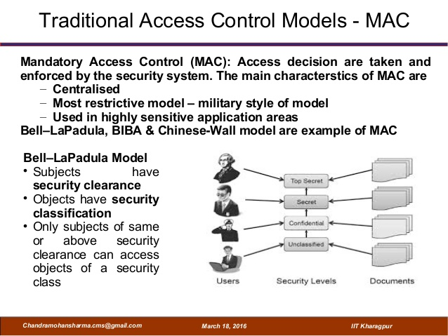

Slide 30
Attribute Based Access Control(ABAC)
Similar to RBAC in the sense that it also adopts a policy driven approach.
Uses attributes of subjects, objects, and the environment (instead of roles).
  Attributes are used to express rich policies
Relieves the need for being registered in the system to be able to access shared resources.
  The case with RBAC based solutions

Slide 31
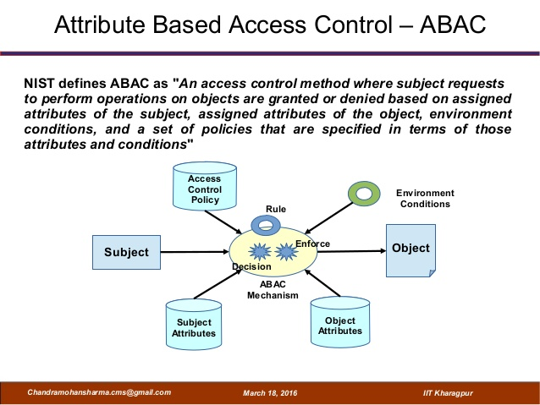

Slide 32



Attribute Based Access Control
The subject who is demanding access to an asset.
Attributes: roles, group memberships, the user’s department / company, management level, certifications or competencies, user ID, etc.
  The action that the user wants to perform are “read” and/or “write”.
  In some situations, the action may be described by a combination of attributes. For example in online banking, you may have “action type= deposit”, and “amount = 1000,-”.
“A user wants to do something with an information asset in a given context”.
A sentence like this includes four grammatical building blocks:
  a subject
  an action
  a resource
  the environment in which the request is made
The environment identifying the context in which access is requested.
Attributes: the current time and location, the type of communication channel, protocol or encryption strength, and/or client type (PC, smart phone, etc.).

Slide 33
Problems with traditional access control models
Static – access controlpermissionss are predetermined
No context – environ conditions are not considered
Too coarse – classification is done at high abstraction level

Slide 34
ABAC Advantage
Dynamic – accesss control permissions are evaluated st the time of actual request is made.
Contextual – environmental conditions may be considered.
Fine grained – attribute based, so detailed rules can be performed

Slide 35
Examples
Using ABAC, we can form rules like:
User can access Server from office.
User can access Server from office during working hours.
User can access Server from home during working hours using laptop only.

Slide 36
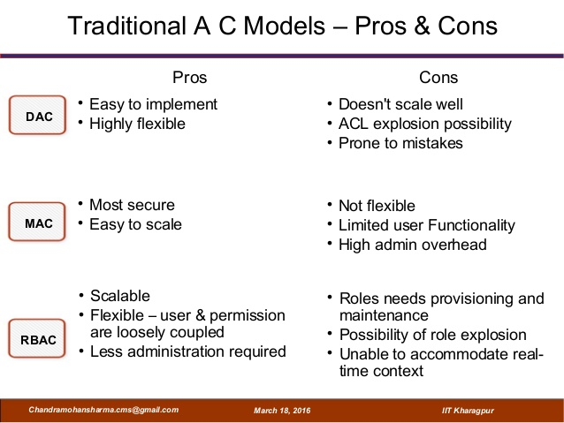

Slide 37
